Slide 1
PRODUCT MANAGEMENT FOR GROWTH & INNOVATION
Product Management
Practices in Personal Lending
CUSTOMER VALUE
PORTFOLIO ECONOMICS
An interview-based analysis of Poonawalla Fincorp
Interviewee Mr. Gaurav Banani, Product Manager – Personal Loans
Submitted by Learning Team 3 | Submitted to Dr. Karan Grover
Dhananjay Singh • Kartikey Gaur • Shivam Kumar • Abhiroop Banerjee • Yash Arora
RISK & COMPLIANCE
FIIB • Academic Year 2026–27
Notes:
[Sources]
- PMGI_Learning_Team_3_Final_Report_With_Call_Evidence(1).docx, cover page and report title.
[/Sources]
Speaker cue:
Open by framing the project as a portfolio-management study of a mature personal-loan product, not a software-feature launch story.

Slide 2
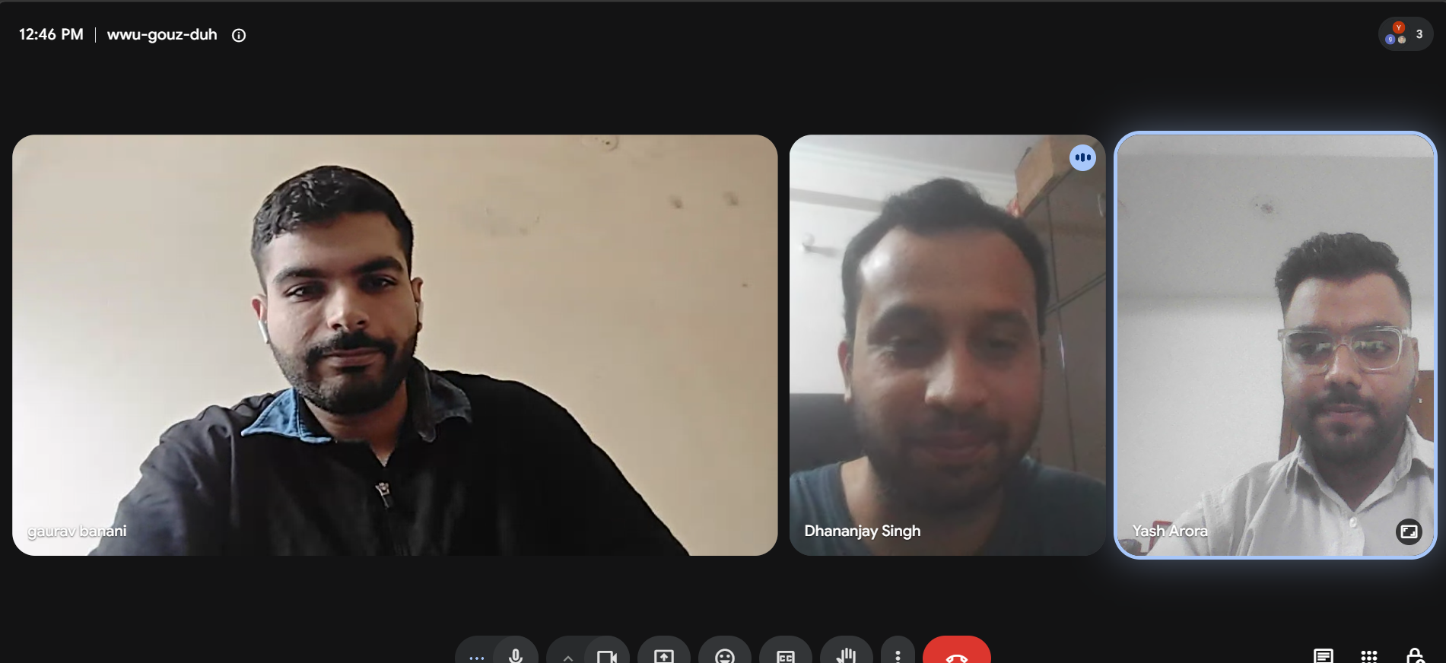
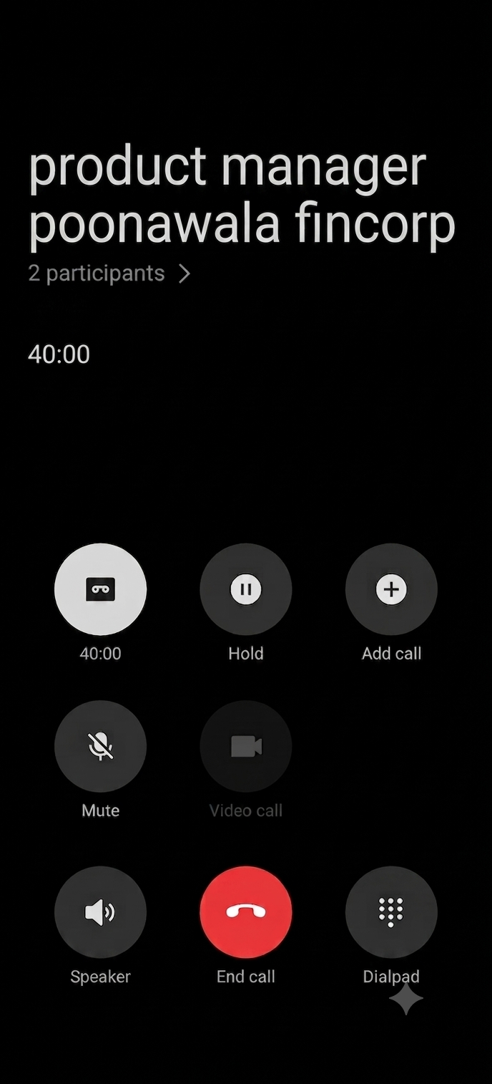






01 RESEARCH DESIGN
INTERVIEW EVIDENCE
02
Recorded interview, structured analysis, traceable conclusions
40
minutes
Semi-structured recorded interview
Primary focus: personal-loan portfolio economics, channel management and lifecycle decisions.
GOOGLE MEET RECORDING
40:00 CALL LOG
Recorded interview
Theme extraction
Scope boundary
PMGI framework mapping
Direct evidence is strongest on budgeting, P&L, channel payouts and portfolio monitoring. Roadmap, metrics and experiments are explicitly presented as Learning Team 3 proposals.
Managerial recommendations
EVIDENCE
Interview statements
TEAM ANALYSIS
Roadmap, metrics & experiments
Notes:
[Sources]
- PMGI_Learning_Team_3_Final_Report_With_Call_Evidence(1).docx, Executive Summary and Methodology; Appendix A.
- Screenshot 2026-08-16 124704.png — user-provided Google Meet evidence.
- Gemini_Generated_Image_qdly6iqdly6iqdly(1).png — user-provided 40-minute call-duration evidence.
[/Sources]
Speaker cue:
Explain the evidence convention before discussing findings. The presentation preserves the report’s distinction between interview evidence and team recommendations.

Slide 3






02 ROLE CONTEXT
INTERVIEW EVIDENCE
03
A lending PM manages a portfolio system—not only a feature backlog
Key insight: pricing, incentives and credit quality are product decisions.
Budget & P&L
Business Targets
Translate approved budgets into operating targets and planned profitability.
Connect manpower and channel capacity with annual growth outcomes.
PORTFOLIO
OUTCOME
Channel Payouts
Sales Incentives
Shape acquisition economics and the quality of sourced business.
Align field behaviour with portfolio and business objectives.
Cross-functional Governance
Coordinate policy, credit, operations, technology and servicing.
Notes:
[Sources]
- PMGI_Learning_Team_3_Final_Report_With_Call_Evidence(1).docx, Section 03 Product and Product-Manager Context.
- PMGI interview transcript, Question 1.
[/Sources]
Speaker cue:
Emphasise that Mr. Banani’s role sits close to the commercial control centre of the portfolio.

Slide 4


03 OPPORTUNITY
INTERVIEW EVIDENCE
04
A large category becomes actionable only after segment and problem choices
MARKET LADDER
₹297L Cr
Total Indian lending market
Beachhead segment
Salaried employees in large private-sector, public-sector and government organisations.
₹156L Cr
Retail lending
STABLE INCOME
VERIFIABLE EMPLOYMENT
DIGITAL DECISIONING
₹16L Cr
Active personal loans
Customer job-to-be-done
“Help me combine multiple loan obligations into one manageable monthly payment — without a slow, confusing or opaque process.”
Interview estimates — not independently verified
15–20% ANNUAL GROWTH
SOM should be tied to channel capacity, risk appetite and unit economics—not market size alone.
Notes:
[Sources]
- PMGI_Learning_Team_3_Final_Report_With_Call_Evidence(1).docx, Section 04 Opportunity, Customer Segment and Value Proposition.
- PMGI interview transcript, Questions 3–5.
[/Sources]
Speaker cue:
State clearly that the market figures are interview estimates. The analytical move is from category size to a risk-appropriate beachhead and a specific repayment problem.

Slide 5



04 VALUE PROPOSITION
INTERVIEW EVIDENCE
05
From multiple obligations to one transparent repayment plan
BEFORE
AFTER
Three lenders. Three due dates. Three servicing journeys.
One loan. One EMI. One service relationship.
Loan A
₹4,000
₹15,000
Loan B
₹10,000
illustrative monthly EMI
CONSOLIDATE
Longer tenure can reduce the monthly burden, but may increase total repayment.
Loan C
₹5,000
₹19,000
Position as transparent debt management—not “instant cash”.
combined monthly EMI
FUNCTIONAL
FINANCIAL
CONVENIENCE
TRUST
One consolidated obligation
Lower monthly EMI potential
Simple digital journey
Clear tenure, fees & total repayment
Notes:
[Sources]
- PMGI_Learning_Team_3_Final_Report_With_Call_Evidence(1).docx, Section 04 Value Proposition.
- PMGI interview transcript, Question 5 — illustrative EMI consolidation example.
[/Sources]
Speaker cue:
Use the before/after visual to explain the customer value, then immediately acknowledge the longer-tenure trade-off.

Slide 6






05 PRODUCT SYSTEM
EVIDENCE + TEAM ANALYSIS
06
Stage-Gate discipline connects customer value with commercial viability
INTERVIEW-DERIVED LIFECYCLE
Discover
Define
Business case
Build
Launch
Learn
Market
Segment
Budget
LOS / LMS
Channels
Book
ILLUSTRATIVE PRICING LOGIC
CONTROLLED GTM LOGIC
1
Target
Stable salaried customers
7%
+
4%
+
3%
=
14%
2
Position
One manageable EMI
Cost of funds
Operating cost
Margin
customer
rate
Pilot
Channel / employer cohort
3
Interview arithmetic only—not actual Poonawalla pricing.
4
Scale
Only after evidence gates
Conversion + credit quality + risk-adjusted contribution
Notes:
[Sources]
- PMGI_Learning_Team_3_Final_Report_With_Call_Evidence(1).docx, Sections 05 and 06.
- PMGI interview transcript, Questions 6–8.
[/Sources]
Speaker cue:
The lifecycle is an informed description of the wider team process. The controlled rollout is a Learning Team 3 recommendation.

Slide 7








06 RISK & PRODUCT-MARKET FIT
INTERVIEW EVIDENCE
07
The winning product is fast enough for customers—and safe enough for the book
Customer speed
Responsible growth
Short forms
Credit bureau & policy checks
Fewer repeated documents
Fraud / identity controls
SUSTAINABLE
PMF
Quick decisions
Privacy & transparent consent
Clear status & rejection
Portfolio-quality guardrails
LENDING PMF IS DELAYED
Profitability
Book behaviour
Market presence
A product may look profitable at launch. The real test appears when the book seasons.
after credit & service costs
delinquency & provisioning
without uneconomic incentives
Notes:
[Sources]
- PMGI_Learning_Team_3_Final_Report_With_Call_Evidence(1).docx, Section 07 Risk, Product-Market Fit and Product Discontinuation.
- PMGI interview transcript, risk discussion and Question 9.
[/Sources]
Speaker cue:
The core insight is that lending PMF cannot be diagnosed from launch conversion or first-year profit alone.

Slide 8







07 OUTCOME ROADMAP
LEARNING TEAM 3 PROPOSAL
08
A 12-month sequence to instrument, validate, serve and scale
Proposed—not Poonawalla Fincorp’s internal roadmap
0–90 DAYS
3–6 MONTHS
6–9 MONTHS
9–12 MONTHS
Instrument the journey
Validate consolidation
Improve service & retention
Scale risk-adjusted growth
Channel & funnel dashboard
Pilot EMI calculator & disclosures
Statements, closure & issue tracking
Increase budget for proven cohorts
Baseline TAT, rejection and cohort quality
Compare direct vs partner cohorts
Analyse repeat / top-up demand
Gate on cost, delinquency & contribution
OUTCOME
Visibility
OUTCOME
Qualified conversion
OUTCOME
Lower service effort
OUTCOME
Sustainable growth
ONGOING GOVERNANCE
Quarterly lifecycle review • regulation watch • incentive review • product kill criteria
Notes:
[Sources]
- PMGI_Learning_Team_3_Final_Report_With_Call_Evidence(1).docx, Section 09 Proposed Outcome Roadmap and Prioritisation.
[/Sources]
Speaker cue:
Present the roadmap as an evidence-led recommendation. The sequence deliberately postpones scaling until journey, credit and contribution signals are visible.

Slide 9







08 DECISION SYSTEM
LEARNING TEAM 3 PROPOSAL
09
One North Star, five metric branches, three practical experiments
NORTH STAR
Activation + portfolio quality + positive expected contribution
Monthly risk-adjusted performing disbursals to the target segment
METRIC TREE
EXPERIMENT BACKLOG
Acquisition
Qualified applications • cost / qualified lead
Transparent consolidation calculator
Qualified completion • complaints • risk mix
Activation
Completion • approval • disbursal conversion • TAT
Retention
On-time EMI • 30+ DPD • service resolution
Quality-linked channel incentive
Contribution • early delinquency • productivity
Revenue
Yield • cost of funds • credit cost • contribution
Simplified document journey
Guardrails
Fraud • complaints • privacy • regulatory breaches
TAT • completion • fraud / policy exceptions
Notes:
[Sources]
- PMGI_Learning_Team_3_Final_Report_With_Call_Evidence(1).docx, Section 10 Metric Tree, Experiments and Risk Controls.
[/Sources]
Speaker cue:
Explain why disbursal volume alone is a poor North Star: it ignores customer suitability, credit quality and contribution.

Slide 10




09 MANAGERIAL TAKEAWAYS
LEARNING TEAM 3 PROPOSAL
10
Five moves to strengthen customer value and portfolio quality
01
02
03
Manage through a risk-adjusted metric tree
Create a continuous discovery cadence
Make consolidation transparent by design
Connect acquisition, conversion, margin, credit cost and mature-cohort performance.
Listen to customers, sales and service teams—even for a mature product.
Show EMI, tenure, total repayment, fees and the customer trade-off.
04
05
Link channel incentives to quality
Pilot, learn and apply lifecycle kill criteria
Reward qualified applications and healthy early repayment—not volume alone.
Scale only after customer, risk and contribution thresholds are met.
Final takeaway
In personal lending, the portfolio is the product: customer value, channel economics, risk and regulation must remain healthy over time.
Notes:
[Sources]
- PMGI_Learning_Team_3_Final_Report_With_Call_Evidence(1).docx, Section 11 Managerial Recommendations and Conclusion.
[/Sources]
Speaker cue:
Close on the distinction between launch success and durable portfolio success. Invite questions on the evidence, proposed roadmap and metric system.

